Slide 1
SWENG3101
Object Oriented Programming
Department of Software Engineering
AASTU

Slide 2
Chapter 2
Basics of Java and Control Statements

Slide 3
Outline
Basics of Java Programming
Conditional and Loops
Arrays
Core Classes of Java

Slide 4
History of java
Java is an object-oriented programming language.
Java was developed by James Gosling and his team at Sun Microsystems in California. Sun formally announced Java at an industry conference in May 1995.
In 1991 Sun funded an internal corporate research project code-named Green. The language was based on C and C++ and was originally intended for writing programs that control consumer appliances such as toasters, microwave ovens, and others.
The language was first called Oak, named after the oak tree outside of Gosling’s office, but the name was already taken, so the team renamed it Java.

Slide 5
Java Application and Java Applet
Java can be used to program two types of programs: Applets and applications.
Applets: are programs called that run within a Web browser. That is, you need a Web browser to execute Java applets.
Applets allow more dynamic and flexible dissemination of information on the Internet
Java Application: is a complete stand-alone program that does not require a Web browser.
A Java application is analogous to a program we write in other programming languages.

Slide 6
Typical Java Environment
Java programs normally undergo five phases
  Edit
    Programmer writes program (and stores program on disk)
  Compile
    Compiler creates bytecodes from program
  Load
    Class loader stores bytecodes in memory
  Verify
    Verifier ensures bytecodes do not violate security requirements
  Execute
    Interpreter translates bytecodes into machine language

Slide 7
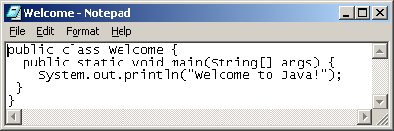
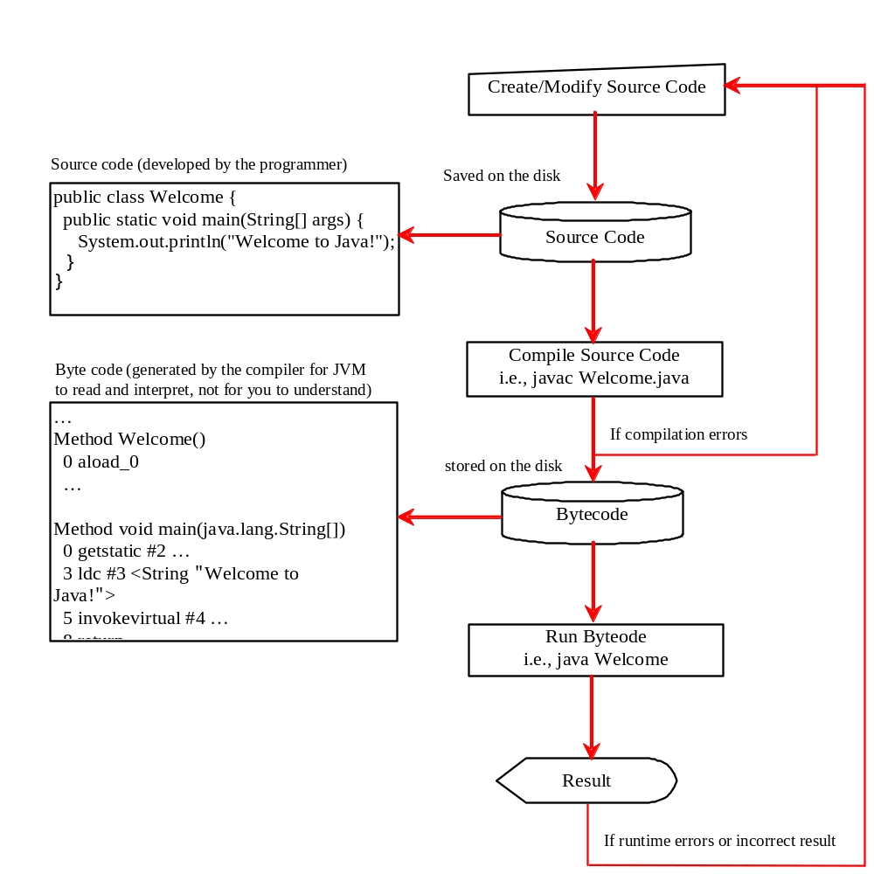
Cont’d…

Slide 8

Cont’d

Slide 9
Typical Java Environment(cont’d)
Phase 1: Creating a Program
  consists of editing a file with an editor program (editor).
  You type a Java program (source code) using the editor, make any necessary corrections and save the program.
  A file name ending with the .java extension indicates that the file contains Java source code
Phase 2: Compiling a Java Program into Bytecodes
  Use the command javac (the Java compiler) to compile a program.
  E.g.: To compile a program called Welcome.java, you would type javac Welcome.java in the command window of your system

Slide 10
Typical Java Environment(cont’d)
  If the program compiles, the compiler produces a .class file called Welcome.class that contains the compiled version of the program.
  The Java compiler translates Java source code into bytecodes that represent the tasks to execute in the execution phase (Phase 5).
  Byte codes are executed by the Java Virtual Machine (JVM).
  Virtual machine (VM) is a software application that simulates a computer, but hides the under-lying operating system and hardware from the programs that interact with the VM.
  Java’s bytecodes are portable. Unlike machine language, which is dependent on specific computer hardware, bytecodes are platform-independent instructions. That is why Java is guaranteed to be Write Once, Run Anywhere.
  The JVM is invoked by the java command.
  For example, to execute a Java application called Welcome, you would type the command java Welcome in a command window to invoke the JVM, which would then initiate the steps necessary to execute the application. This begins Phase 3.

Slide 11
Typical Java Environment(cont’d)
Phase 3: loading: placing the program in memory before executing it.
  The class loader takes the .class files containing the program’s bytecodes and transfers them to primary memory.
  The .class files can be loaded from a disk on your system or over a network (e.g., your local college or company network, or the Internet).
Phase 4: Bytecode Verification
  bytecode verifier examines their bytecodes to ensure that they are valid and do not violate Java’s security restrictions.
  Java enforces strong security, to make sure that Java programs arriving over the network do not damage your files or your system (as computer viruses and worms might).

Slide 12
Typical Java Environment(cont’d)
Phase 5: Execution
  The JVM executes the program’s bytecodes, thus performing the actions specified by the program.
  In early Java versions, the JVM would interpret and execute one bytecode at a time; Java programs execute slowly.
  Today’s JVMs typically execute bytecodes using a combination of interpretation and so-called just-in-time (JIT) compilation.
    The JVM analyzes the bytecodes as they are interpreted, searching for hot spots— parts of the bytecodes that execute frequently.
Integrated development environment (IDE) combines these steps into a single task.
  A graphical user interface is available for editing, compiling, linking, and running the application.
  Example: NetBeans, Eclipse, Jbuilder, etc.

Slide 13
Activity
Describe:
  Compile time error
  Run-time error
  Logical error
What is Java bytecode?

Slide 14
Java Features
Object Oriented
Simple
  Java is partially modeled on C++, but greatly simplified and improved
Architectural-neutral: Java compiler generates an architecture-neutral object file format which makes the compiled code to be executable on many processors
  Platform independent
  Portable
  Java promise: “Write once, run everywhere”.
Multithreaded
  possible to write programs that can do many tasks simultaneously.

Slide 15
Java Features(cont’d)
Robust: measures how well the program runs under various conditions.
  Java compilers can detect many problems that would first show up at execution time in other languages.
  Java has a runtime exception-handling feature to provide programming support for robustness.
Distributed
  Java applications can open and access objects across the Net via URLs with the same ease as when accessing a local file system.
Both compiled and interpreted language.
High Performance: With the use of Just-In-Time compilers, Java enables high performance.
Secure

Slide 16
Java Program Structure
In the Java programming language:
  A program is made up of one or more classes
  A class contains one or more methods
  A method contains program statements
A Java application always contains a method called main
  Java program processing starts from the main()

Slide 17
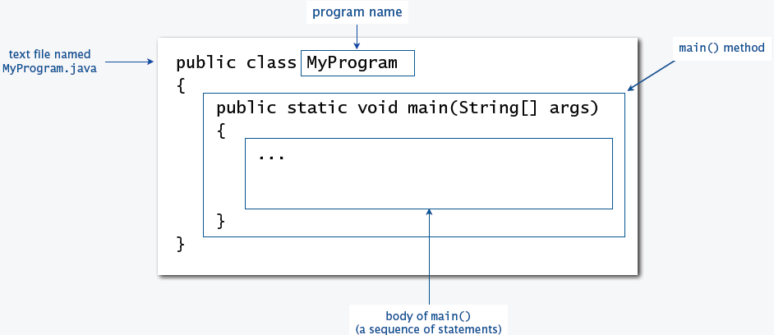
Java Program Structure(cont’d)

Slide 18
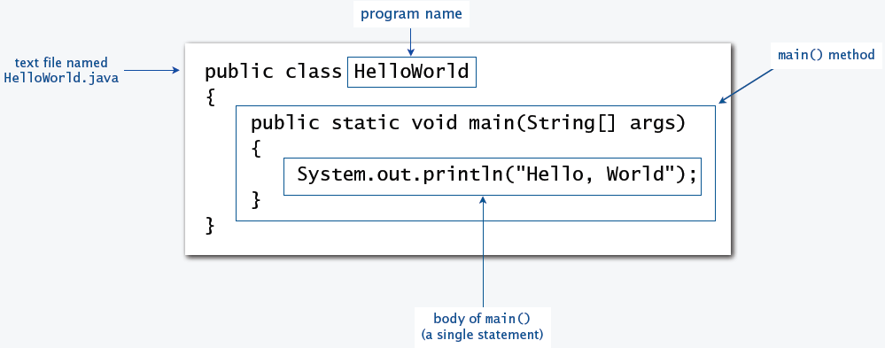
Java Program Structure(cont’d)

Slide 19
First Java Program
A simple code that would print the words Hello World.
public class MyFirstJavaProgram {
public static void main(String[ ] args) {
System.out.println("Hello World");
}
}

Slide 20
Class Names and Identifiers
Java is a case sensitive E.g. Hello is different from hello
Class Names - For all class names the first letter shall be in Upper Case. If several words are used to form a name of the class, each inner word's first letter should be in Upper Case.
  Example class MyFirstJavaClass
Method Names - All method names shall start with a lower case letter. If several words are used to form the name of the method, then each inner word's first letter should be in Upper Case.
  Example: public void myMethodName()
Program File Name - Name of the program file should exactly match the class name.
  Example: Assume 'MyFirstJavaProgram' is the class name. Then the file should be saved as 'MyFirstJavaProgram.java'.

Slide 21
Cont’d
Names used for classes, variables and methods are called identifiers.
  All identifiers should begin with a letter (A to Z or a to z), currency character ($) or an underscore (_).
  After the first character identifiers can have any combination of letters, digit, $, and _.
  A key word cannot be used as an identifier.
  Identifiers are case sensitive.
  Examples of legal identifiers: age, $salary, _value, __1_value
  Examples of illegal identifiers: 123abc, -salary

Slide 22
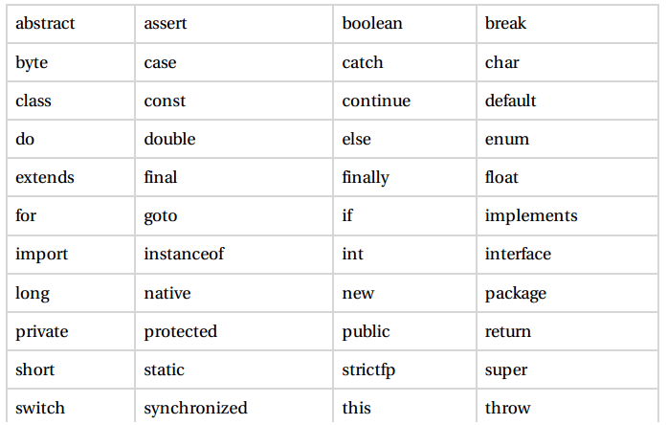
Java Keywords
The following list shows the reserved words in Java. These reserved words may not be used as constant or variable or any other identifier names.

Slide 23
Comments in Java
E.g.
public static void main(String []args){
// This is an example of single line comment
/* This is also an example of
multline comment. */
System.out.println("Hello World");
}
}

Slide 24
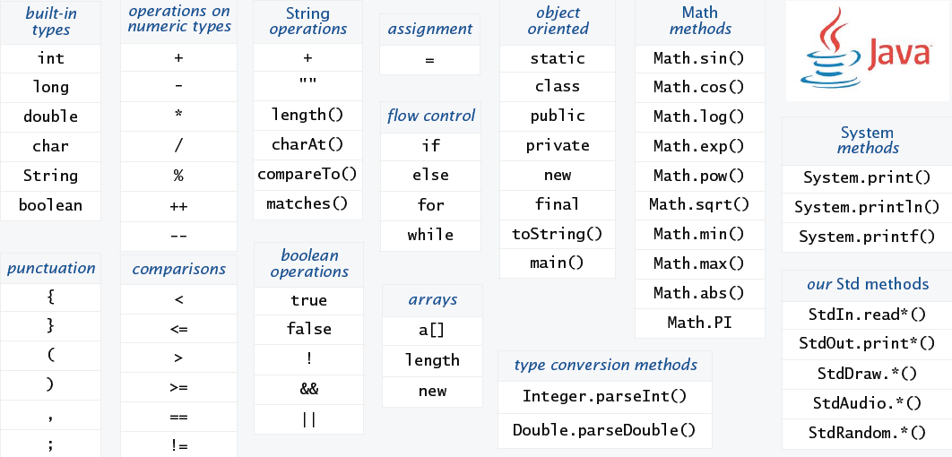
Java language vocabulary
Your programs will primarily consist of these plus identifiers (names) that you make up

Slide 25
Variable
A variable is a name for a location in memory
You must declare all variables before they can be used. The basic form of a variable declaration is:
  data type variable [ = value][, variable [= value] ...] ;
E.g. int a, b, c; // Declares three ints, a, b, and c.
  int a = 10, b = 10; // Example of initialization
  byte B = 22; // initializes a byte type variable B.
  double pi = 3.14159; // declares and assigns a value of PI.
  char a = 'a'; // the char variable a is initialized with value ‘a’
  char tm = ‘\u2122’; // \u2122 is the trademark symbol
data type
variable name
int total;

Slide 26
Data Types
There are two data types available in Java:
  Primitive Data Types
  Reference/Object Data Types
Data Type | Size | Range
byte | 1 byte | Integers in the range of -128 to +128
short | 2 bytes | Integers in the range of -32,768 to +32,767
int | 4 bytes | Integers in the range of -2,147,483,648 to +2,147,483,647
long | 8 bytes | Integers in the range of -9,223,372,036,854,775,808 to +9,223,372,036,854,775,807
float | 4 bytes | Floating-point numbers in the range of ±3.4x10⁻³⁸ to ±3.4x10³⁸ with 7 digits of accuracy
double | 8 bytes | Floating-point numbers in the range of ±1.7x10⁻³⁰⁸ to ±1.7x10³⁰⁸ with 15 digits of accuracy
char | 2 bytes | A single character
Boolean | 1 byte | true or false

Slide 27
Constants
A constant is an identifier that is similar to a variable except that it holds the same value during its entire existence
Example:
  byte a = 68;
  char a = 'A'
In Java, we use the final modifier to declare a constant final int MIN_HEIGHT = 69;

Slide 28
print and println Methods
We can invoke the println method to print a character string
The System.out object represents a destination (the monitor screen) to which we can send output
The print method is similar to the println method, except that it does not advance to the next line
Therefore anything printed after a print statement will appear on the same line
System.out.println ("Whatever you are, be a good one.");
object
method
name
information provided to the method
(parameters)

Slide 29
Escape Sequence
What if we wanted to print a the quote character?
The following line would confuse the compiler because it would interpret the second quote as the end of the string
  System.out.println ("I said "Hello" to you.");
An escape sequence is a series of characters that represents a special character
An escape sequence begins with a backslash character (\)
System.out.println ("I said \"Hello\" to you.");

Slide 30
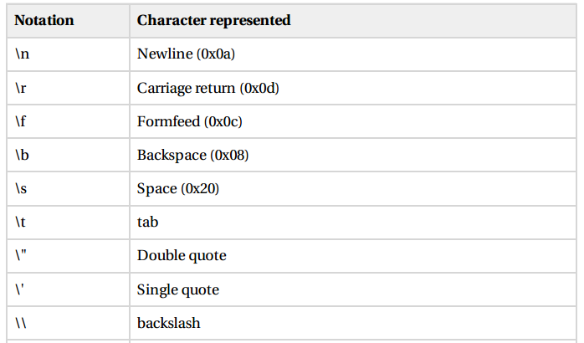

Escape Sequence

Slide 31
EscapeExample.java
public class EscapeExample{
public static void main( String[] args){
System.out.println("Hello World");
System.out.println("two\nlines");
System.out.println("\"This is in quotes\"");
}
}
Output:
Hello World
two
lines
“This is in quotes”

Slide 32
String
A string of characters can be represented as a string literal by putting double quotes around the text:
Examples:
  "This is a string literal."
  "123 Main Street"
There are close to 50 methods defined in the String class. We will introduce some of them here:
substring
  E.g. String text;
  text = "Espresso";
  System.out.print(text.substring(2, 7)); //char at end position is not included
  Output: press
length
  Example
    text1 = ""; //empty string
    text2 = "Hello";
    text3 = "Java";
    text1.length( ) //output: 0
    text2.length( ) //output: 5
    text3.length( ) //output: 4
Notes:
- substring(2)

Slide 33
String(cont’d)
equals
  Returns true if the calling object string and the Other_String are equal. Otherwise, returns false.
  Example
    String greeting = "Hello";
    greeting.equals("Hello") returns true
    greeting.equals("hello") returns false
toLowerCase
  Convert to lowercase
    String greeting = "Hi Mary!";
    greeting.toLowerCase() returns “hi mary!".
toUpperCase
  Convert to uppercase
    String greeting = "Hi Mary!";
    greeting.toUpperCase() returns "HI MARY!".

Slide 34
String(cont’d)
Indexof
  Locate the index position of a substring within another string
  Example
    text = "I Love Java and Java loves me.";
    text.indexOf("J") =7
    text.indexOf("love") =21
    text.indexOf("ove") =3
String concatenation
  Use the plus symbol (+) for string concatenation
    string text1 = "Jon";
    string text2 = "Java";
    text1 + text2--------- "JonJava"
    text1 + " " + text2--------- "Jon Java"
    "How are you, " + text1 + "?"-------------- "How are you, Jon?"
Notes:
pause = " Hmm ";
pause.trim( );

Slide 35
StringExample.java
public class StringExample{
public static void main(String[] args) {
String text1=“Hello", text2 = “World“;
String text3 = "I Love Java and Java loves me.";
System.out.println(text1.substring(1,3));
System.out.println(text2.length());
System.out.println(text3.indexOf("I"));
System.out.println(text1+" "+text2);
}
}
Output:?

Slide 36
Type Conversion/Casting
A value in any of the built-in types we have seen so far can be converted (type-cast) to any of the other types.
For example:
  (int) 3.14 // converts 3.14 to an int 3
(double) 2 // converts 2 to a double to give 2.0
Integer division always results in an integer outcome.
  E.g. 9/2 gives 4 not 4.5
  E.g. 8.2/2=4.1 implicit conversion/promotion
Notes:
Widening Casting (automatically) - converting a smaller type to a larger type size
byte -> short -> char -> int -> long -> float -> double
Narrowing Casting (manually) - converting a larger type to a smaller size type
double -> float -> long -> int -> char -> short -> byte

Slide 37
Java Basic Operators
Java provides a rich set of operators to manipulate variables. We can divide all the Java operators into the following groups:
  Arithmetic Operators
  Relational Operators
  Logical Operators
  Assignment Operators

Slide 38
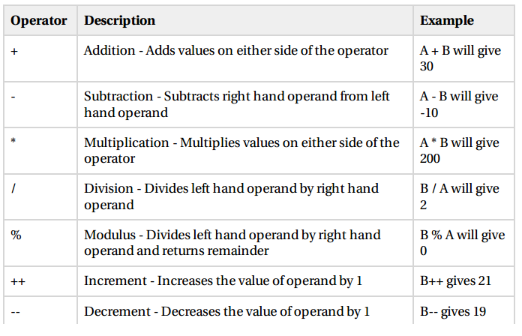
Arithmetic Operator
int quotient, remainder;
quotient = 7 / 3;
remainder = 7 % 3;
System.out.println("quotient = " + quotient);
System.out.println("remainder = " + remainder);

Slide 39
Example
public class Test{
public static void main(String[] args){
int a =10;
int b =20;
int c =25;
int d =25;
System.out.println("a + b = "+(a + b));
System.out.println("a - b = "+(a - b));
System.out.println("a * b = "+(a * b));
System.out.println("b / a = "+(b / a));
System.out.println("b % a = "+(b % a));
System.out.println("c % a = "+(c % a));
System.out.println("a++ = "+(a++));

Slide 40
Example(cont’d)
System.out.println(“a-- = "+(a--));
// Check the difference in d++ and ++d
System.out.println("d++ = "+(d++));
System.out.println("++d = "+(++d));
}
}
This would produce the following result:
  a + b = 30
  a - b = -10
  a * b = 200
  b / a = 2
  b % a = 0
  c % a = 5
  a++ = 10
  a-- = 11
  d++ = 25
  ++d = 27

Slide 41
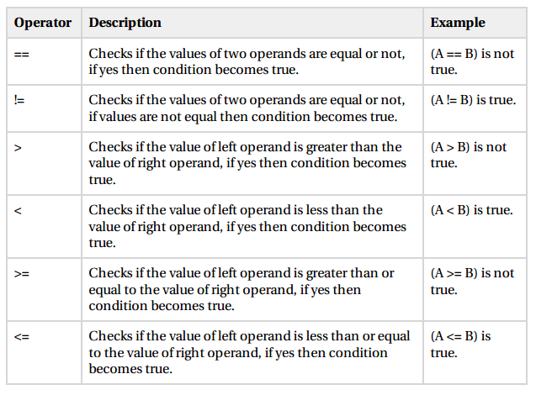
The Relational Operator
Assume variable A holds 10 and variable B holds 20

Slide 42
Example
public class Test{
  public static void main(String[] args){
    int a =10;
    int b =20;
  System.out.println("a == b = "+(a == b));
  System.out.println("a != b = "+(a != b));
  }
}
This would produce the following result:
  a == b =false
  a != b =true

Slide 43
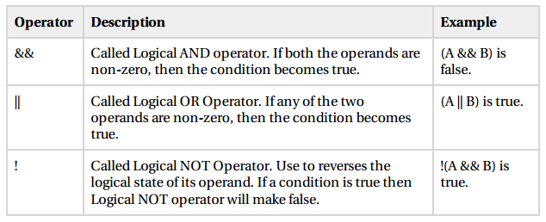
The Logical Operators
Assume variable A holds 1 and variable B holds 0

Slide 44
Example
public class Test{
public static void main(String[] args){
boolean t =true;
boolean f =false;
System.out.println("t && f = "+(t&&f));
System.out.println("t || f = "+(t||f));
System.out.println("!(t && f) = "+!(t && f));
}
}
This would produce the following result:
  t && f =false
  t || f =true
  !(t && f)=true

Slide 45
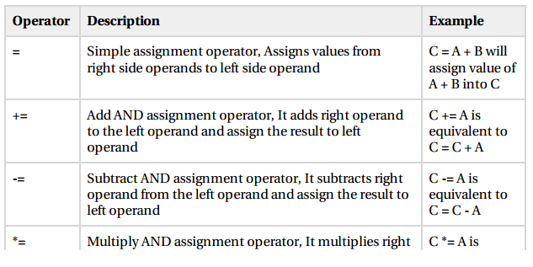
The Assignment Operator

Slide 46
Conditional Statements
Two types:
  If statements
  Switch statements
Syntax of if statements
  if(expression){
  //Statements will execute if the expression is true
  }

Slide 47
Example
public class Test {
public static void main(String[] args){
int x = 10;
if( x < 20 ){
System.out.print("This is if statement");
}
}
}
Output
This is if statement

Slide 48
if…else statement
An if statement can be followed by an optional else statement, which executes when the expression is false.
if(expression){
//Executes when the expression is true
}else{
//Executes when the expression is false
}

Slide 49
Example 1
public class Test2 {
public static void main(String[] args){
int x = 30;
if( x < 20 ){
System.out.print("This is if statement");
}
else{
System.out.print("This is else statement");
}
}
}
Output:
This is else statement

Slide 50
Example2
public class Test3 {
public static void main(String[] args){
int x = 30;
if( x == 10 ){
System.out.print("Value of X is 10");
}
else if( x == 20 ){
System.out.print("Value of X is 20");
}
else if( x == 30 ){
System.out.print("Value of X is 30");
}
else{
System.out.print("This is else statement");
}
}
}

Slide 51
Activity
Write a java program to check whether a number is even or not
Write a java program that reads two integers and displays in ascending order.
  import java.util.Scanner;
  public class TwoSort{
    public static void main(String[] args){
      Scanner console = new Scanner(System.in);
      int a= console.nextInt();
      int b = console.nextInt();
      if (b < a){
        int t = a;
        a = b;
        b = t;
      }
      System.out.println(a);
      System.out.println(b);
    }
  }

Slide 52

Exercise
Write a java program that displays the following picture.
Write a java program that arrange three numbers in ascending order.

Slide 53
Switch
Handles multiple conditions efficiently.
switch(expression){
case value :
//Statements
break; //optional
case value :
//Statements
break; //optional
//You can have any number of case statements.
default : //Optional
//Statements
}

Slide 54
Example
public class SwitchTest {
public static void main(String[] args){
char grade = 'C';
switch(grade){
case 'A' :
System.out.println("Excellent!");
break;
case 'B' :
System.out.println("Well done");
break;
case 'C' :
System.out.println("You passed");
break;
case 'D' :
System.out.println("You Failed");
case 'F' :
System.out.println("Better try again");
break;
default :
System.out.println("Invalid grade");
}System.out.println("Your grade is " + grade);
}
}

Slide 55
Loop
There may be a situation when we need to execute a block of code several number of times, and is often referred to as a loop.
You can use one of the following three loops:
  while Loop
      while (condition) {
      statements
      }
  for Loop
      for (initialization; condition; update){
      statements
      }
  do...while Loop
    do {
    (statements )
    } while ( boolean-expression ) );

Slide 56
Example 1
Displaying all squares of numbers 1 to 10
  public static void main(String[] args) {
  int i=1;
  while(i<=10){
  System.out.println(i*i);
  i++;
  }
  }

Slide 57
Example 2: Nested loop
for (int i = 0; i < 3; i++) {
for (int j = 2; j < 4; j++) {
System.out.println (i + “ “ + j);
}
}

Slide 58
Exercise
Write a program to display sum of the first 100 integer numbers using for loop.
Write statements that can be used in a Java program to read two integers and display the number of integers that lie between them, including the integers themselves. For example, four integers are between 3 and 6: 3, 4, 5, and 6.
Write a program that reads an integer value and prints the sum of all even integers between 2 and the input value, inclusive. Print an error message if the input value is less than 2.
Write a java program that accepts integer value from a user and display sum of each digit(E.g. input: 543, result: 5+4+3=12)

Slide 59
Basic Classes
1. System: one of the core classes
  System.out.println( "Welcome to Java!" );
  System.out.print(“…”);
  System.exit(0);
  System.out.println("50 plus 25 is " + 50 + 25);

Slide 60
Basic Classes(cont’d)
2. Scanner:
  The java.util.Scanner: for accepting input from console
  Methods: nextInt(), nextDouble(), nextLine(), next(), …
  E.g.:- Scanner s = new Scanner (System.in);
  int x = s.nextInt();

Slide 61
Example 1
  import java.util.Scanner; // so that I can use Scanner
  public class Age{
  public static void main(String[] args) {
  Scanner console = new Scanner(System.in);
  System.out.print("How old are you? "); // prompt
  int age = console.nextInt();
  System.out.println("You'll be 30 in " + (30 - age) + " years.");
  }
  }
Output:
How old are you? 18
You’ll be 30 in 12 years

Slide 62
Example 2
import java.util.*;
public class HelloName{
public static void main(String[] args){
Scanner input= new Scanner(System.in);
System.out.print("What is your name? ");
String name = input.nextLine();
System.out.println("Hello there " + name + ", nice to meet you!");
}
}
Output:
What is your name? James
Hello there James, nice to meet you!

Slide 63
Example3
import java.util.Scanner; // program uses class Scanner
// Addition program that displays the sum of two numbers.
public class AdditionExample{
// main method begins execution of Java application
public static void main( String[] args){
Scanner input = new Scanner( System.in );
int number1; // first number to add
nt number2; // second number to add
int sum; // sum of number1 and number2
System.out.print( "Enter first integer: " ); // prompt
number1 = input.nextInt(); // read first number from user
System.out.print( "Enter second integer: " ); // prompt
number2 = input.nextInt(); // read second number from user
sum = number1 + number2; // add numbers
System.out.println( "Sum is “ + sum );
} // end method main
} // end class Addition

Slide 64
Basic Classes(cont’d)
3. Math-Class
The java.lang.Math class contains methods for performing basic numeric operations such as exponential, logarithm, square root, and trigonometric functions
  Math.ceil(x) //Math.ceil(3.2) and Math.ceil(3.9) both return 4.0
  Math.floor(x) // Math.floor(3.2) and Math.floor(3.9) both return 3.0
  Math.pow(x,y) //Math.pow(4,2) returns 16.0
  Math.round(x) //Math.round(3.2) returns 3; Math.round(3.6) returns 4
  Math.max(x,y) // Math.max(1, 2) returns 2
  Math.sqrt(x) // Math.sqrt(4) returns 2.0
  Math.random(): a random floating point number between 0 and 1. generates a double value in the range [0,1)
    Eg: Math.random()*100
  Math.toDegrees(x);
  Math.PI
  Math.sin(x)

Slide 65
Basic Classes(cont’d)
Random is a class used to generate random numbers between the given lists/ranges.
Example:
import java.util.Random;
  public class RandomExample {
  public static void main(String[] args) {
  double x []=new double[20];
  Random r=new Random();
  Scanner s=new Scanner(System.in);
  for(int i=0;i<5;i++){
  x[i]=r.nextInt(100);
  System.out.println(x[i]);
  }
  }
  }

Slide 66
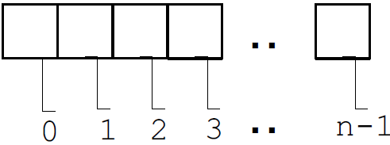
Arrays
Stores a fixed-size sequential collection of elements of the same type.
The index starts at zero and ends at length-1.
To create an array of a given size, use the operator new:
  Data type arrayname[] = new dataType[size];
  E.g. int[] values = new int[5];
The for loop is ideally suited for performing array manipulations
  E.g. Int[] values = {9, 15, 18}; //initializing array
  for (int i = 0; index < values.length; i++){
    System.out.println(values[i]);
    }

Slide 67
Example
Create an array with N random values
    double[] a = new double[N];
    for (int i = 0; i < N; i++)
    a[i] = Math.random();
Copy to another
    double[] b = new double[N];
    for (int i = 0; i < N; i++)
    b[i] = a[i];
Print array values, one per line
    for (int i = 0; i < N; i++)
    System.out.println(a[i]);
Find the maximum of array values
    double max = a[0];
    for (int i = 1; i < N; i++)
    if (a[i] > max) max = a[i];
Matrix addition
    double[][] c = new double[N][N];
    for (int i = 0; i < N; i++)
    for (int j = 0; j < N; j++)
    c[i][j] = a[i][j] + b[i][j];
Notes:
char[] a = {'A', ' ', 'B', 'i', 'g', ' ', 'H', 'i', '!'};
String s = new String(a);

Slide 68
Cont’d
import java.util.*;
public class ArrayExample{
public static void main(String[] args) {
float x []=new float[5]; //array declaration
System.out.println("enter any five numbers");
for(int i=0;i<5;i++){
x[i]=input.nexFloat();
sum =sum+x[i];
}
System.out.println("result="+sum);
}
}

Slide 69
Activity
What is wrong with the following?
  int[] temp = {7, 2, 1.5, 4};
  int[] temp= new int[5];
  temp[] = {7, 5, 9};
Write a program that prompts the user to enter two lists of integers and displays whether the two are identical

Slide 70
Exercise: Array
Write a java program that accepts 5 integers and display
    the smallest
    only evens
    Count only integers>50
Insert N-integers from the keyboard and calculate the sum and average
Generate 5 random numbers between 10 and 20 and find the smallest
Generate 5 random numbers between 1 and 50 and find the largest two
Insert a string using Scanner and count the number of ‘a’ in the string
Check if the inserted string is palindrome or not

Slide 71
Lab Exercise
Write a program that reverses the digits of a given positive integer number entered from the keyboard(don’t use array).
Write a program that prompts the user to enter a string and displays the number of vowels and consonants in the string.
Write a program that determines and print the number of odd, even, and zero digits in an integer value read from the keyboard
Write a program that reads a string from the user and prints it one character per line.

Slide 72
What does the following code fragment print?
int[] a = { 1, 2, 3 };
int[] b = { 1, 2, 3 };
System.out.println(a == b);

